Slide 1
GRADE 7 ACCELERATED · UNIT 3 · THREAD A · DAY 2
Negative Exponents with Variable Bases
MA.8.AR.1.1
I can rewrite an algebraic expression with negative exponents using only positive exponents, and apply several laws of exponents to a monomial expression.
Yesterday every exponent on a letter was positive.
Today x⁻³ arrives — and it is not a negative number.
Grade 7 Accelerated · Unit 3 · Thread A · Day 2 — Negative Exponents with Variable Bases
1

Slide 2
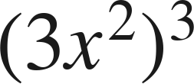

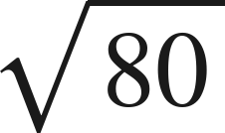

Warm-Up
On your own. Four minutes. No notes.
1. Write as a single monomial:
2. Find the value:
3. Which is greater,
or 9?
4. What is the reciprocal of
?
Grade 7 Accelerated · Unit 3 · Thread A · Day 2 — Negative Exponents with Variable Bases
2

Slide 3

Warm-Up
Answers.
1. Write as a single monomial:
27x⁶
2. Find the value:
1/25
3. Which is greater,
or 9?
9
4. What is the reciprocal of
?
Grade 7 Accelerated · Unit 3 · Thread A · Day 2 — Negative Exponents with Variable Bases
3

Slide 4
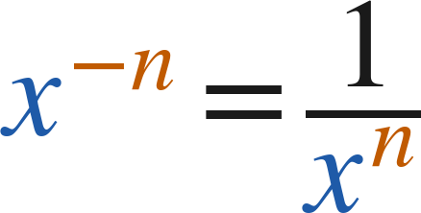
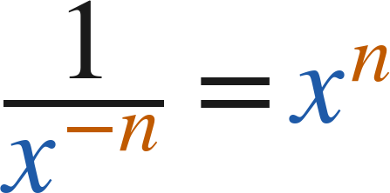
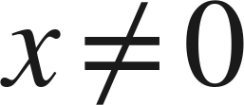
Notes
Copy the table.
I. The pattern, with a letter
x⁴ | x³ | x² | x¹ | x⁰ | x⁻¹ | x⁻² | x⁻³
x·x·x·x | x·x·x | x·x | x | 1 | 1/x | 1/x² | 1/x³
(
)
Grade 7 Accelerated · Unit 3 · Thread A · Day 2 — Negative Exponents with Variable Bases
4

Slide 5
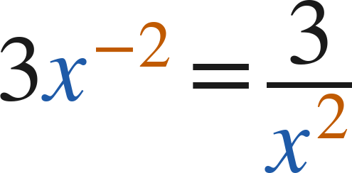
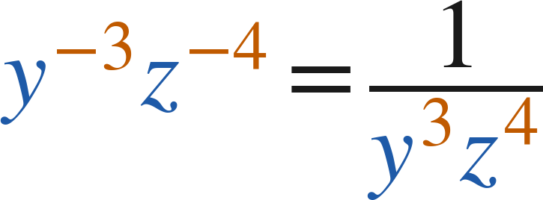
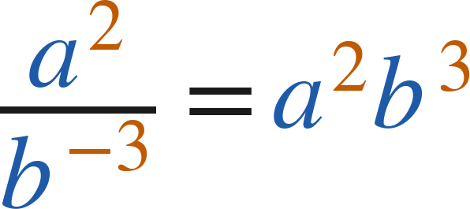
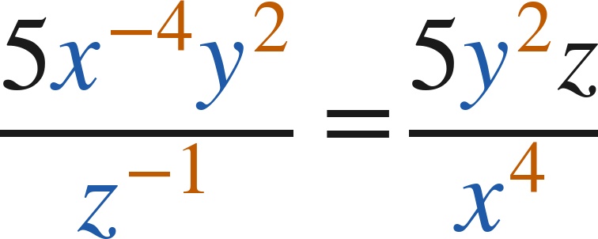
Notes
II. Moving factors across the fraction bar
Only the factor with the negative exponent moves. Its exponent turns positive.
Grade 7 Accelerated · Unit 3 · Thread A · Day 2 — Negative Exponents with Variable Bases
5

Slide 6
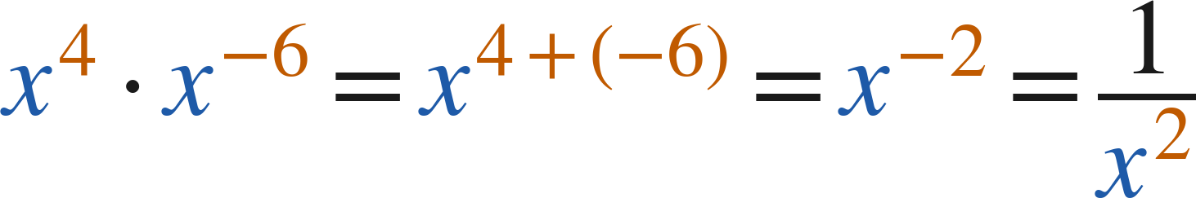
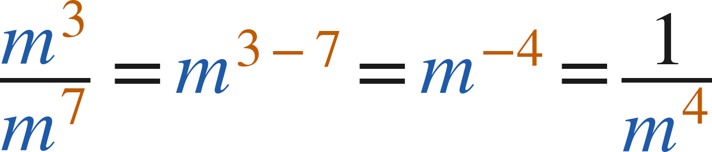
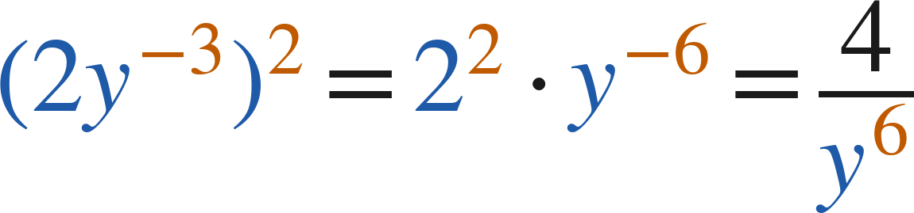
Notes
III. The laws with negative exponents
Apply the law. Then rewrite so that every exponent is positive.
Grade 7 Accelerated · Unit 3 · Thread A · Day 2 — Negative Exponents with Variable Bases
6

Slide 7
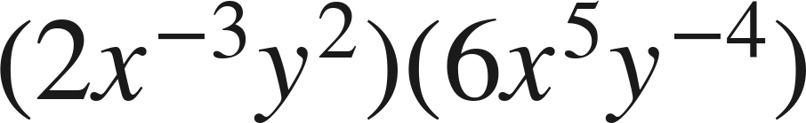
Example 1
Multiplying monomials with negative exponents.
Write an equivalent expression with positive exponents only.
Grade 7 Accelerated · Unit 3 · Thread A · Day 2 — Negative Exponents with Variable Bases
7

Slide 8
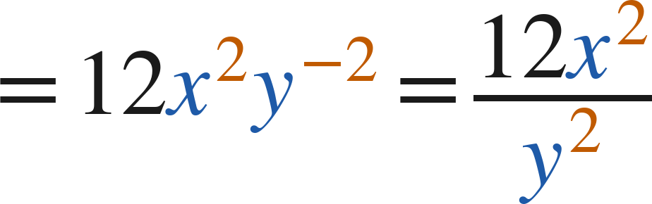
Example 1
Worked.
multiply coefficients; add exponents
move y⁻² down; the 12 and the x² stay up
Answer: 12x²/y²
Grade 7 Accelerated · Unit 3 · Thread A · Day 2 — Negative Exponents with Variable Bases
8

Slide 9
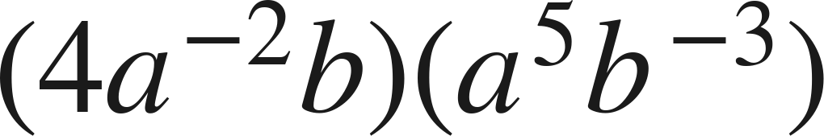
Your Turn
Same steps, your numbers. Boards up when done.
Grade 7 Accelerated · Unit 3 · Thread A · Day 2 — Negative Exponents with Variable Bases
9

Slide 10
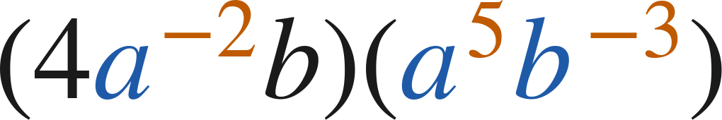
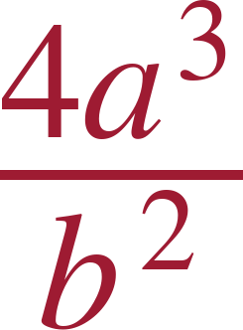
Your Turn
Answer.
4 · a³ · b⁻²
Answer:
Grade 7 Accelerated · Unit 3 · Thread A · Day 2 — Negative Exponents with Variable Bases
10

Slide 11
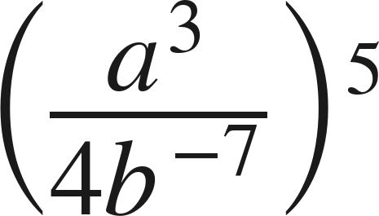
Example 2
Several laws in one expression — the state guide's item.
Write an equivalent expression with positive exponents only.
Grade 7 Accelerated · Unit 3 · Thread A · Day 2 — Negative Exponents with Variable Bases
11

Slide 12
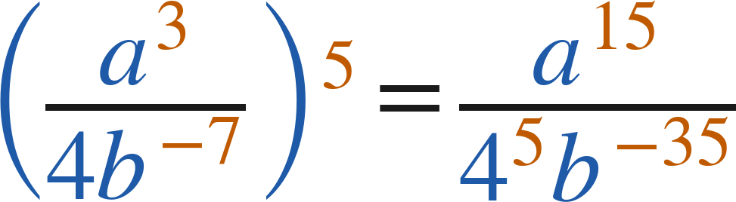
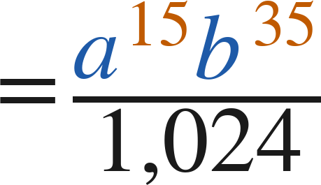
Example 2
Worked.
raise every factor: a³, 4, b⁻⁷
4⁵ = 1,024; b⁻³⁵ moves up as b³⁵
Answer: a¹⁵b³⁵/1,024
Grade 7 Accelerated · Unit 3 · Thread A · Day 2 — Negative Exponents with Variable Bases
12

Slide 13
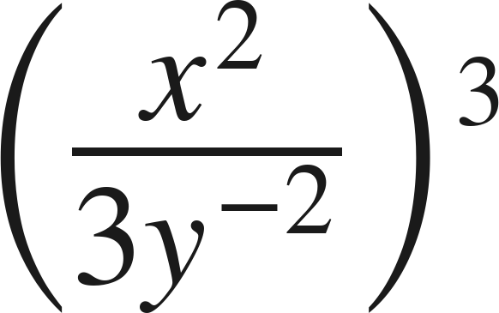
Your Turn
Same steps, your numbers. Boards up when done.
Grade 7 Accelerated · Unit 3 · Thread A · Day 2 — Negative Exponents with Variable Bases
13

Slide 14
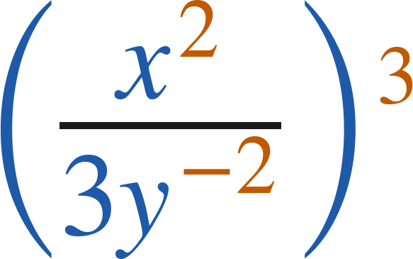
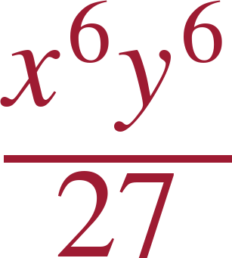
Your Turn
Answer.
x⁶ over 27y⁻⁶, then move the y up
Answer:
Grade 7 Accelerated · Unit 3 · Thread A · Day 2 — Negative Exponents with Variable Bases
14

Slide 15
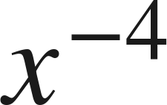
Whiteboards · Question 1 of 9
Boards up on three.
Answer it.
Rewrite with a positive exponent.
Grade 7 Accelerated · Unit 3 · Thread A · Day 2 — Negative Exponents with Variable Bases
15

Slide 16
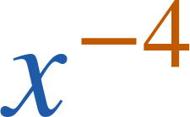

Whiteboards · Question 1 of 9
Answer.
reciprocal of x⁴
Answer:
Grade 7 Accelerated · Unit 3 · Thread A · Day 2 — Negative Exponents with Variable Bases
16

Slide 17
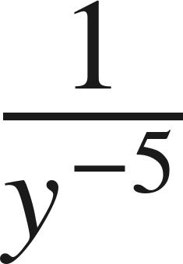
Whiteboards · Question 2 of 9
Boards up on three.
Answer it.
Rewrite with a positive exponent.
Grade 7 Accelerated · Unit 3 · Thread A · Day 2 — Negative Exponents with Variable Bases
17

Slide 18
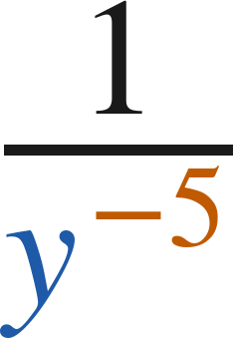

Whiteboards · Question 2 of 9
Answer.
the power moves up
Answer:
Grade 7 Accelerated · Unit 3 · Thread A · Day 2 — Negative Exponents with Variable Bases
18

Slide 19
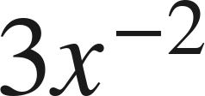
Whiteboards · Question 3 of 9
Boards up on three.
A model's scale factor is
.
The model is 12 centimeters long.
Rewrite the factor using only positive exponents.
Answer it.
Rewrite with a positive exponent.
Grade 7 Accelerated · Unit 3 · Thread A · Day 2 — Negative Exponents with Variable Bases
19

Slide 20
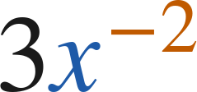

Whiteboards · Question 3 of 9
Answer.
A model's scale factor is
.
The model is 12 centimeters long.
Rewrite the factor using only positive exponents.
only the x moves
Answer:
Grade 7 Accelerated · Unit 3 · Thread A · Day 2 — Negative Exponents with Variable Bases
20

Slide 21
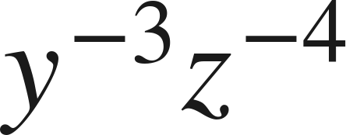
Whiteboards · Question 4 of 9
Boards up on three.
Answer it.
Rewrite with positive exponents.
Grade 7 Accelerated · Unit 3 · Thread A · Day 2 — Negative Exponents with Variable Bases
21

Slide 22
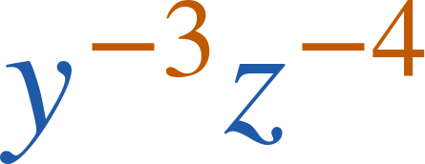
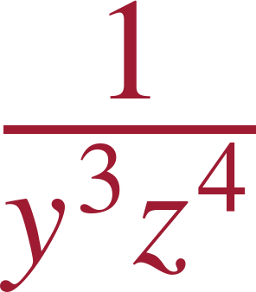
Whiteboards · Question 4 of 9
Answer.
both factors move down
Answer:
Grade 7 Accelerated · Unit 3 · Thread A · Day 2 — Negative Exponents with Variable Bases
22

Slide 23
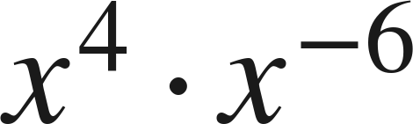
Whiteboards · Question 5 of 9
Boards up on three.
Which expression is equivalent?
A. −x²
B. 1/x²⁴
C. 1/x²
D. x¹⁰
Answer it.
Grade 7 Accelerated · Unit 3 · Thread A · Day 2 — Negative Exponents with Variable Bases
23

Slide 24
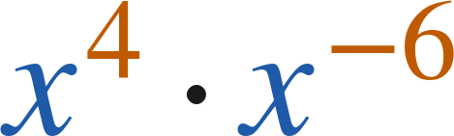
Whiteboards · Question 5 of 9
Answer.
Which expression is equivalent?
A. −x²
B. 1/x²⁴
C. 1/x²
D. x¹⁰
Answer: C — 1/x²
Grade 7 Accelerated · Unit 3 · Thread A · Day 2 — Negative Exponents with Variable Bases
24

Slide 25
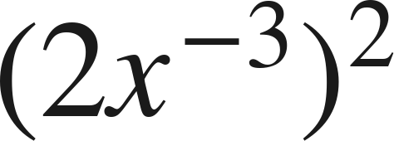
Whiteboards · Question 6 of 9
Boards up on three.
Which expression is equivalent?
A. 4/x
B. 1/(4x⁶)
C. 2/x⁶
D. 4/x⁶
Answer it.
Grade 7 Accelerated · Unit 3 · Thread A · Day 2 — Negative Exponents with Variable Bases
25

Slide 26
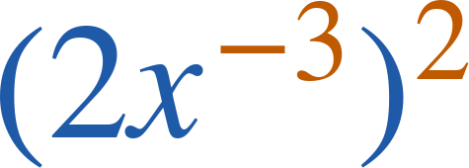
Whiteboards · Question 6 of 9
Answer.
Which expression is equivalent?
A. 4/x
B. 1/(4x⁶)
C. 2/x⁶
D. 4/x⁶
Answer: D — 4/x⁶
Grade 7 Accelerated · Unit 3 · Thread A · Day 2 — Negative Exponents with Variable Bases
26

Slide 27
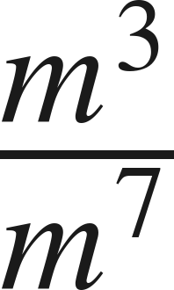
Whiteboards · Question 7 of 9
Boards up on three.
Answer it.
Write with a positive exponent.
Grade 7 Accelerated · Unit 3 · Thread A · Day 2 — Negative Exponents with Variable Bases
27

Slide 28
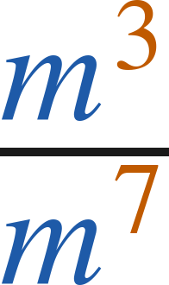

Whiteboards · Question 7 of 9
Answer.
m⁻⁴ — then rewrite
Answer:
Grade 7 Accelerated · Unit 3 · Thread A · Day 2 — Negative Exponents with Variable Bases
28

Slide 29

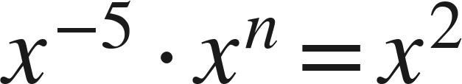
Whiteboards · Question 8 of 9
Boards up on three.
Find the value of
:
Answer it.
Which law applies?
Grade 7 Accelerated · Unit 3 · Thread A · Day 2 — Negative Exponents with Variable Bases
29

Slide 30
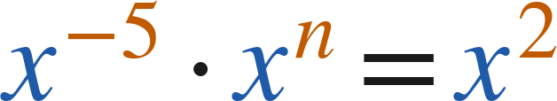
Whiteboards · Question 8 of 9
Answer.
Find the value of
:
−5 + n = 2
Answer: n = 7
Grade 7 Accelerated · Unit 3 · Thread A · Day 2 — Negative Exponents with Variable Bases
30

Slide 31
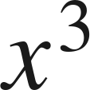
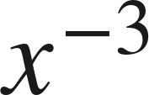

Whiteboards · Question 9 of 9
Take your time. Boards up when you have written it.
How are
and
related?
Explain, and give the value of each when
.
Write your answer in sentences.
Use the word reciprocal.
Grade 7 Accelerated · Unit 3 · Thread A · Day 2 — Negative Exponents with Variable Bases
31

Slide 32

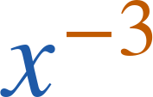

Whiteboards · Question 9 of 9
Answer.
How are
and
related?
Explain, and give the value of each when
.
reciprocals: 8 and 1/8
Answer: x⁻³ is the reciprocal of x³. When x = 2: x³ = 8 and x⁻³ = 1/8.
Grade 7 Accelerated · Unit 3 · Thread A · Day 2 — Negative Exponents with Variable Bases
32

Slide 33
Independent Set
Six questions. On your own, in silence.
1.
Six questions. Work down the page.
2.
Show the step that does the work, not just the answer.
3.
Silence until the six minutes are up.
Grade 7 Accelerated · Unit 3 · Thread A · Day 2 — Negative Exponents with Variable Bases
33

Slide 34
IXL
Last five minutes.
1.
Open IXL and start today's skills.
2.
Work on paper where the question needs work. The answer box does not show it.
3.
Every skill listed is required, to a SmartScore of 67. Due at the start of the next class.
Today's skills — all required
Variables with negative exponents — 2NL
Multiply and divide powers: variable bases — 85P
Grade 7 Accelerated · Unit 3 · Thread A · Day 2 — Negative Exponents with Variable Bases
34

